Slide 1

Solution for Long Filepath/Filename Issues
January 2024

Slide 2
Content
Problem Statement
Proposed Solution Overview
Implementation and Testing Conclusion and Q&A

Slide 3
Problem Statement

Slide 4
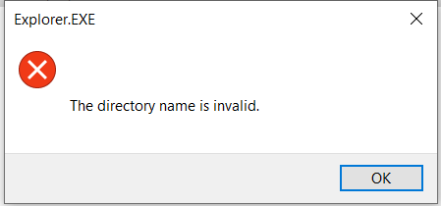
Long Filepath/Filename Script – Why?
For the A220 Separation project, some of the file paths or filenames we have transferred are longer than 256 in length.
Common error when trying to access long file longer than 256 in length, will look like this:
This will cause user unable to access or modify the file.

Slide 5
Proposed Solution Overview

Slide 6
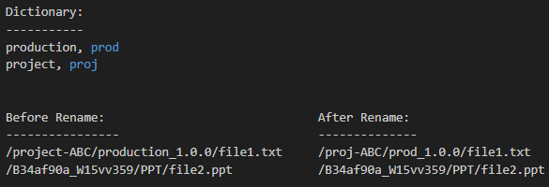
Purpose Solution Abbreviate Filename/Directory Based On Customizable Dictionary
A Python-based script specifically designed to shorten those file path and filename.
Core Functionality:
1) Scan Directories for File Paths or Files Exceeding a Set Length Limit.
2) Abbreviation Strategy and User Configurable Dictionary to Transform Long Path/Filename
Customizability
Readability
User Control
Note: The dictionary will need to be manually created by CGI or Airbus.
Notes:
Can customize based on different naming convention, diff. drops, diff. projects
Abbreviations maintain more context and readability of the original path
Enable users to maintain control over how their path are shorten, ensuring flexibility for future drops

Slide 7
Purpose Solution Abbreviate Filename/Directory Based On Customizable Dictionary
Secondary Functionality:
Logging
Detailed CSV on All Modified Files
Configurable Shorten Length
Post Operation Check
File Attributes and File Hash check to ensure file integrity
However, this will increase process time

Slide 8
Other Factors Related to the Script
Number of Files
Based on our research and testing, rename operation will not change file contents.
File Size
Based on our research, individual file size is not a significant factor in rename operations.
The script will also batch process the rename operation to improve flexibility.

Slide 9
Precaution
Backup
The script will mainly perform rename operation, will NOT modify data. However, an up-to-date backup is recommended before the rename operation.
Ensure your backup solution will NOT consider renamed paths as new files.

Slide 10
Workflows of the Script

Slide 11
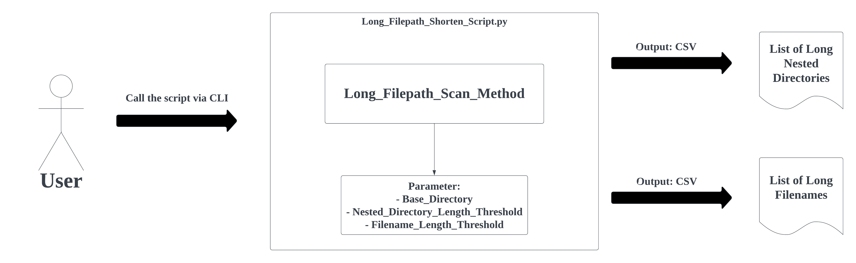
Sample Flow – Scan Directories for File Paths or Files

Slide 12
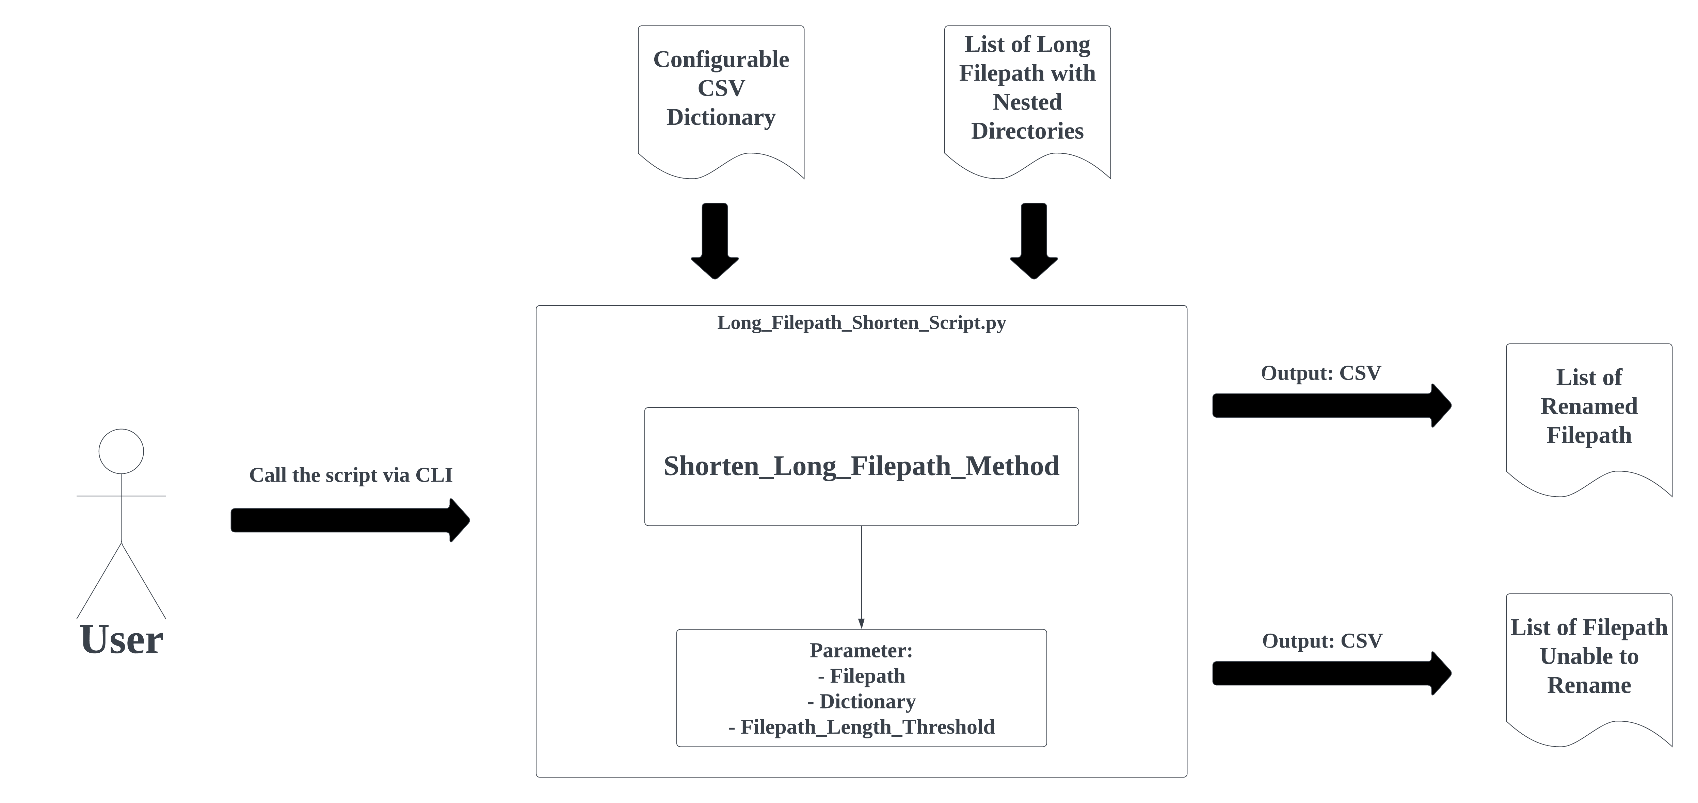
Sample Flow – Shorten Long Filepath with Long Nested Directories

Slide 13
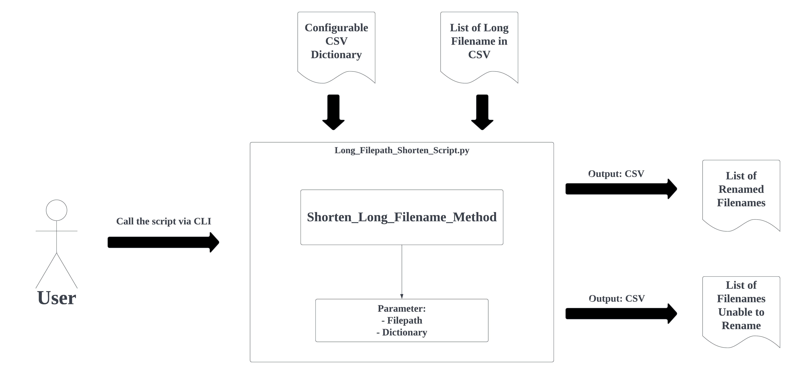
Sample Flow – Shorten Long Filename

Slide 14
Implementation Testing Strategy and Documentation

Slide 15
Implementation, Testing Strategy and Documentation Overview
Targeted Users
The script will be run in CLI and is tailored for use by technical users.
Streamlined Testing Process
Thorough testing on local machines to ensure reliability
Then collaborative testing with intended users to ensure the script meets their specific needs
Knowledge Transfer and Support
Knowledge transfer session will be held to demonstrate script usage
Extensive documentation will be provided, covering workflow, usage instructions, and troubleshooting guidelines.

Slide 16
Q&A

